Slide 1

AtliQ Hospitality Analysis
Report by: deepan R
Unid: umip5710

Slide 2

Agenda
Atliq Grands owns multiple five-star hotels across India. They have been in the hospitality industry for the past 20 years. Due to strategic moves from other competitors and ineffective decision-making in management, Atliq Grands are losing its market share and revenue in the luxury/business hotels category. As a strategic move, the managing director of Atliq Grands wanted to incorporate “Business and Data Intelligence” in order to regain their market share and revenue.
However, they do not have an in-house data analytics team to provide them with these insights. Their revenue management team had decided to hire a 3rd party service provider to provide them with insights from their historical data.

Slide 3
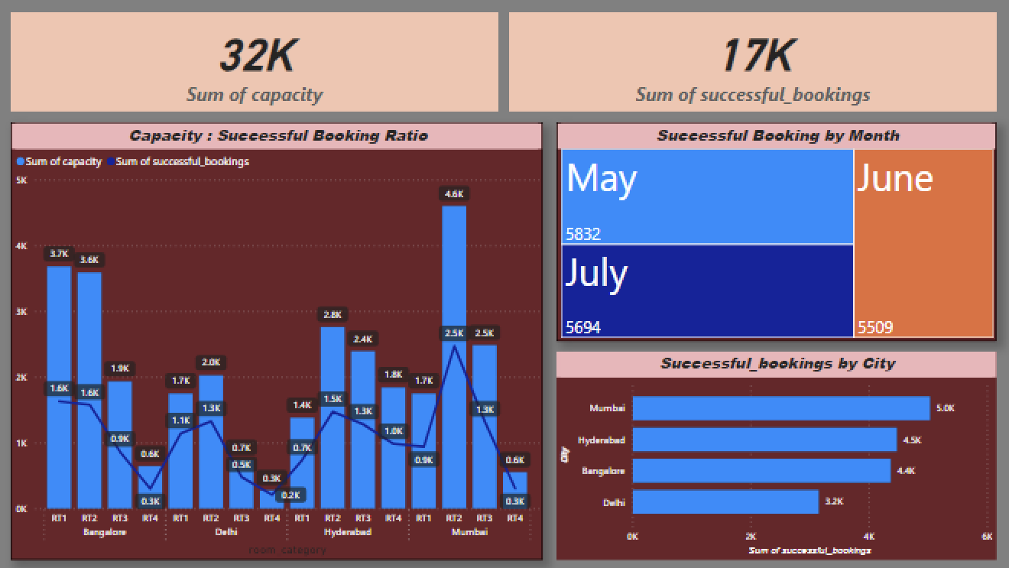
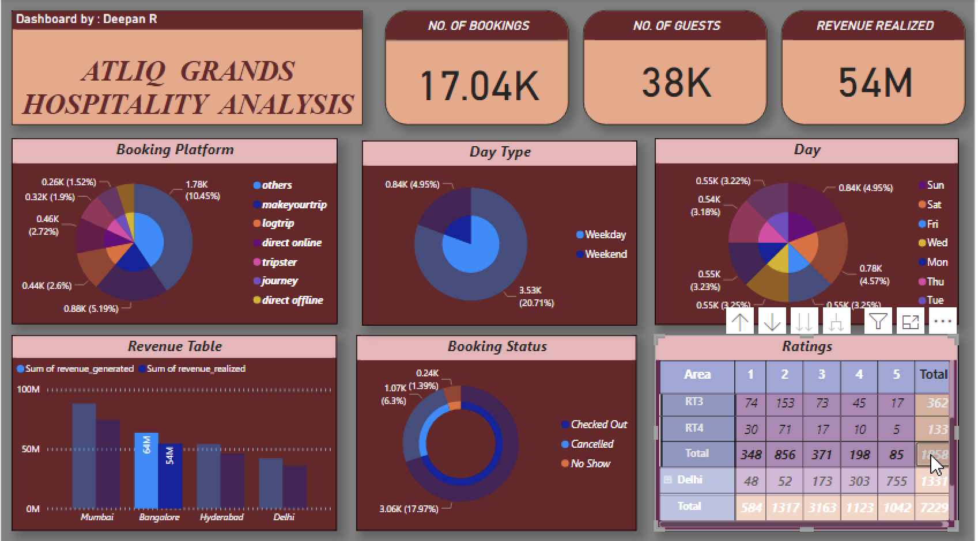
KPI' S – Key Performance Indicators
Booking platform
Ratings given
Booking status
Check in date
Check out date
Booking date
Capacity and Successful bookings
City
Room type
Revenue generated and realized

Slide 4

Dashboards

Slide 5
Analysis - I
AtliQ Grands provide services in 4 cities – Delhi, Mumbai, Hyderabad, Bangalore
Out of these places Mumbai has great market in grands category
And Delhi has the least market for the grands category
And all the four branches provide 4 types of rooms – standard, elite, privilege, ultra-privilege
Ratings can help in improving things
Sum of capacity gives the number of rooms available
Sum of successful bookings shows total number of bookings done successfully without cancelation and the bookings status is also given as reference for calculating this
And the booking status has three categories – Check out, Cancelled, No show, in this cancelled will have to pay 40% of the booking revenue/amount to the hotel as cancellation fees and for other two categories amount/revenue is 100%
Date can be used for analysis over period

Slide 6
Analysis - II
It is observed to be total number of bookings is 17,040 and out of this successful booking is 100%
No. of guests stayed is calculated to 38,000 so average of 2 people stay in 1 room
Public uses hospitality service during weekdays than weekend. But considered day wise Sunday and Saturday has most bookings day wise
According to revenue table Mumbai branch has generated highest, Delhi generated least and other two have generated a decent amount
A total of 212 Million $ have been realized with these 4 branches
In total 4 branches has a capacity of 32k but bookings done is almost only half that is 17k
When seeing month-wise all three months – May, June and July have almost equal number of bookings
And most people have checked out successfully without cancelling, but concern is 25% people have cancelled and 5% have not shown up, which adds up to 30%

Slide 7

Thank you !

